Slide 1






DiversIT - EPR
.CSV
Wilson – Aisari – Danylo – Anfisa – Girik
.HL7

Slide 2
DiversIT - EPR
Wilson – Aisari – Danylo – Anfisa – Girik
.CSV
Problem: Variety of Data
.HL7
How do we make it easier?

Slide 3
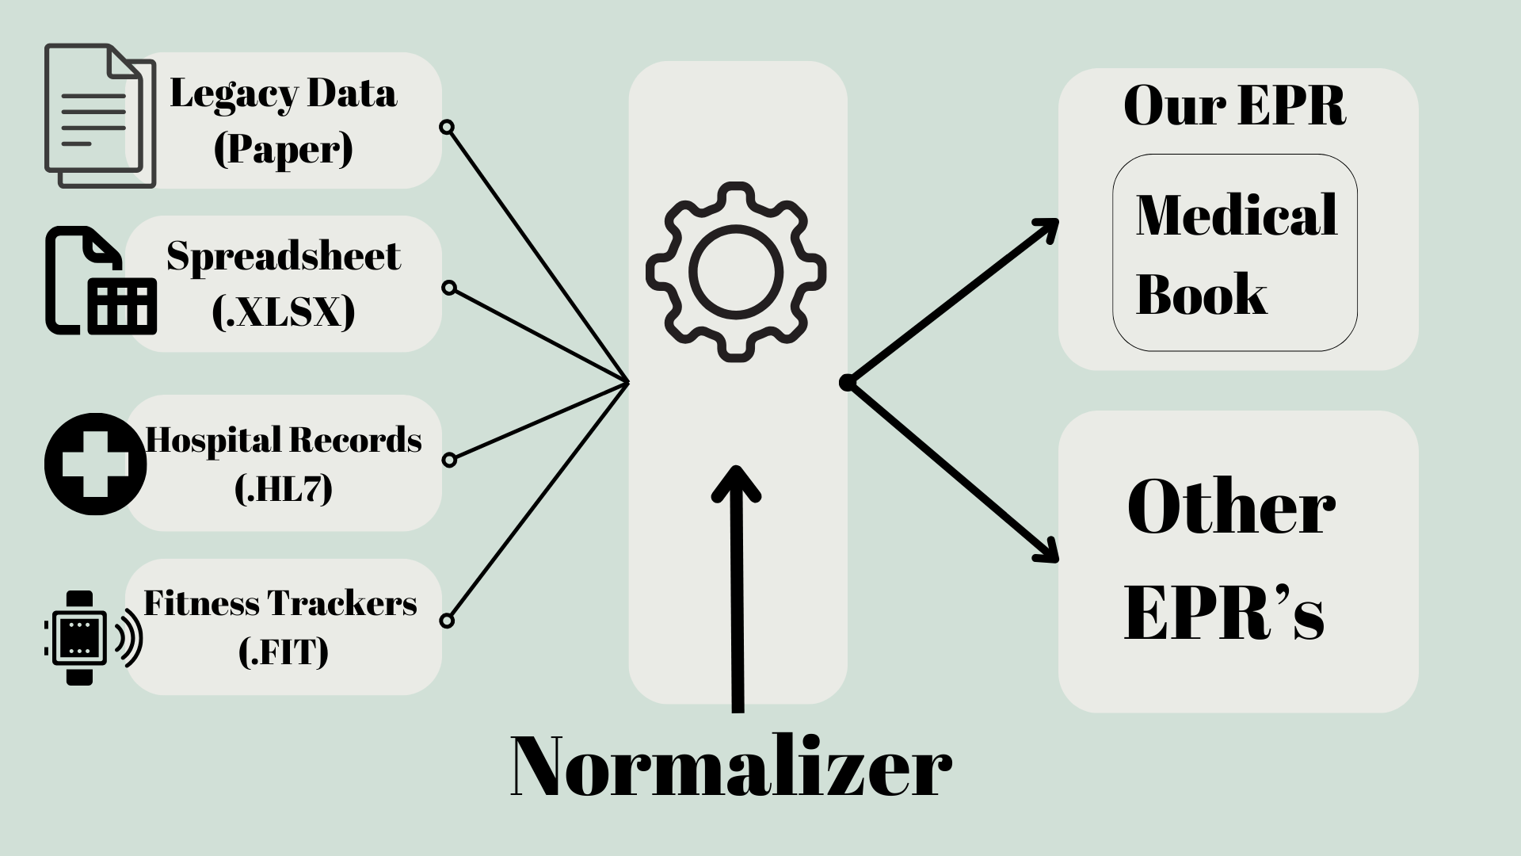
How do we make it easier?
.CSV
.HL7

Slide 5
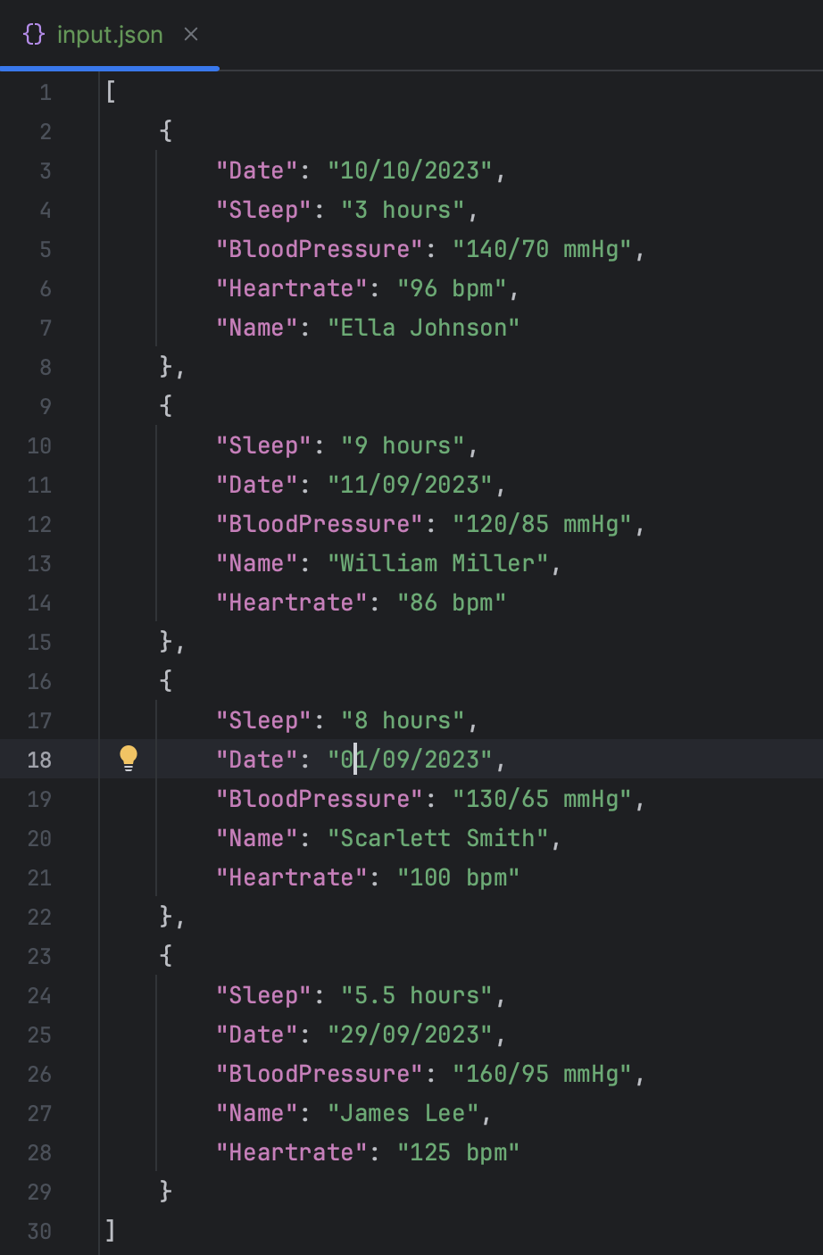
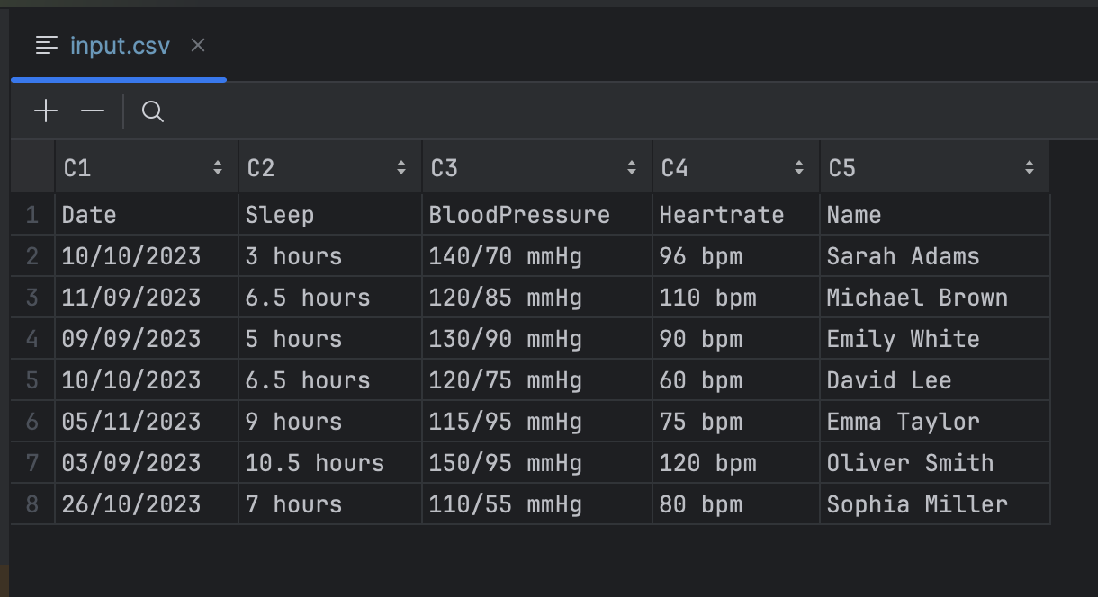
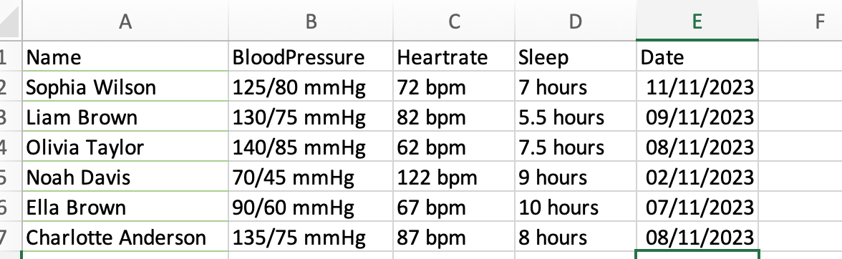

Slide 7
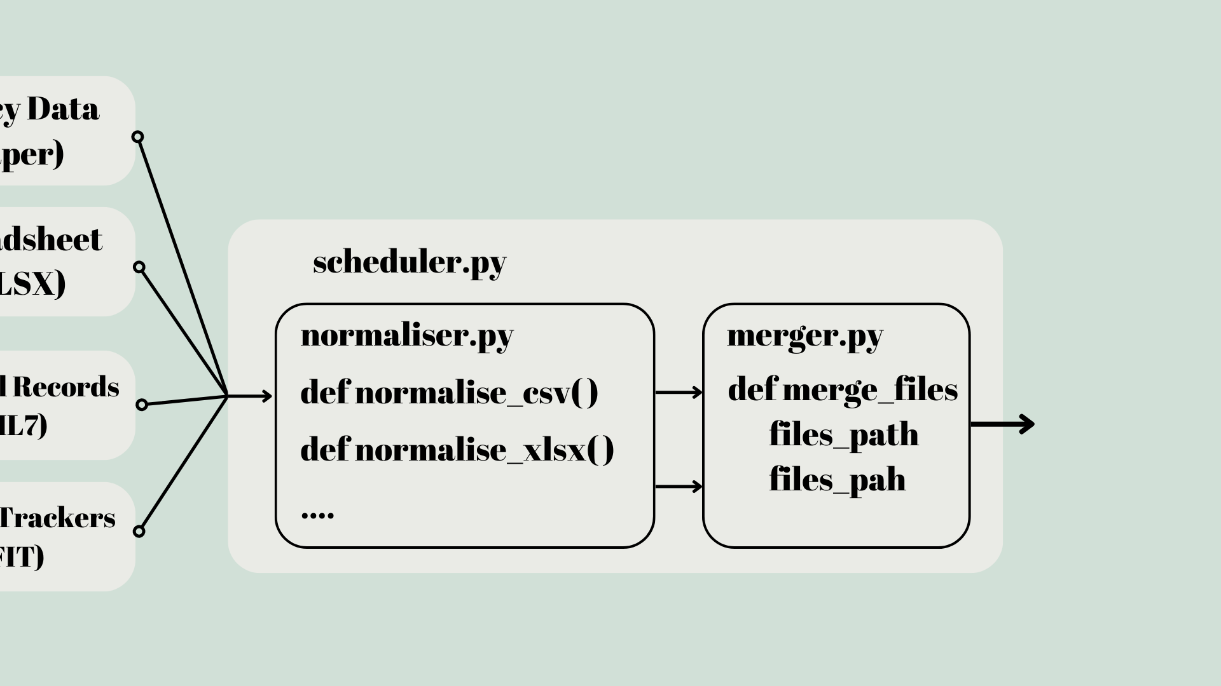

Slide 8
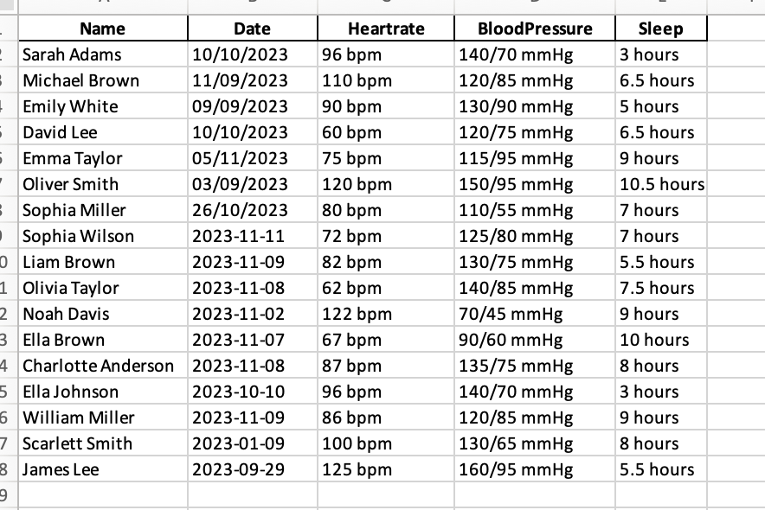

Slide 9



Cheaper
User-friendly
Versatile

Slide 10
Cheaper
User-friendly
Versatile

Slide 11
What makes it expensive?
Infrastructure Cost
Migration of Data

Slide 12


Infrastructure Cost
- Cloud Host
- Modular Design
- Use of personal phones
Our
Solution
Migration of Data
Versatile

Slide 13
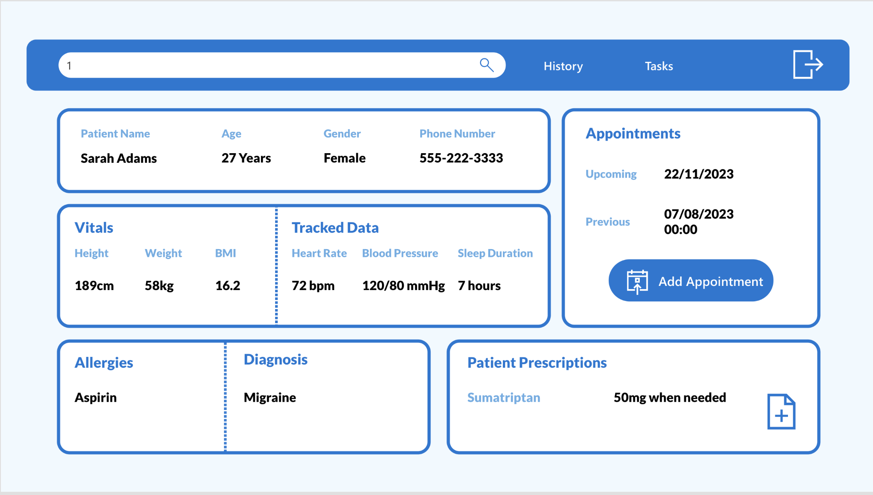
Our
Solution
-Standardized data
- Modular code for updates
- Cloud-based servers for easy scalability
Versatile

Slide 14
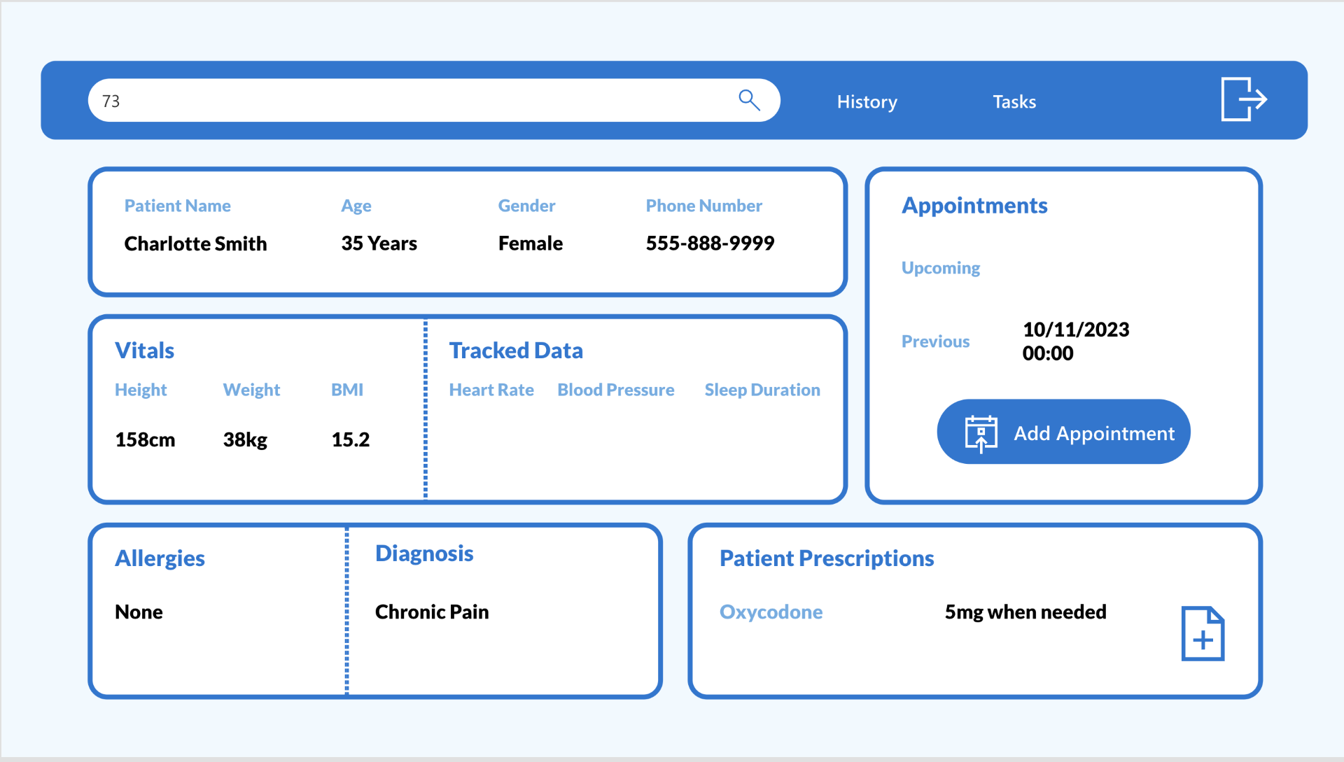
Our
Solution
User-Friendly

Slide 15
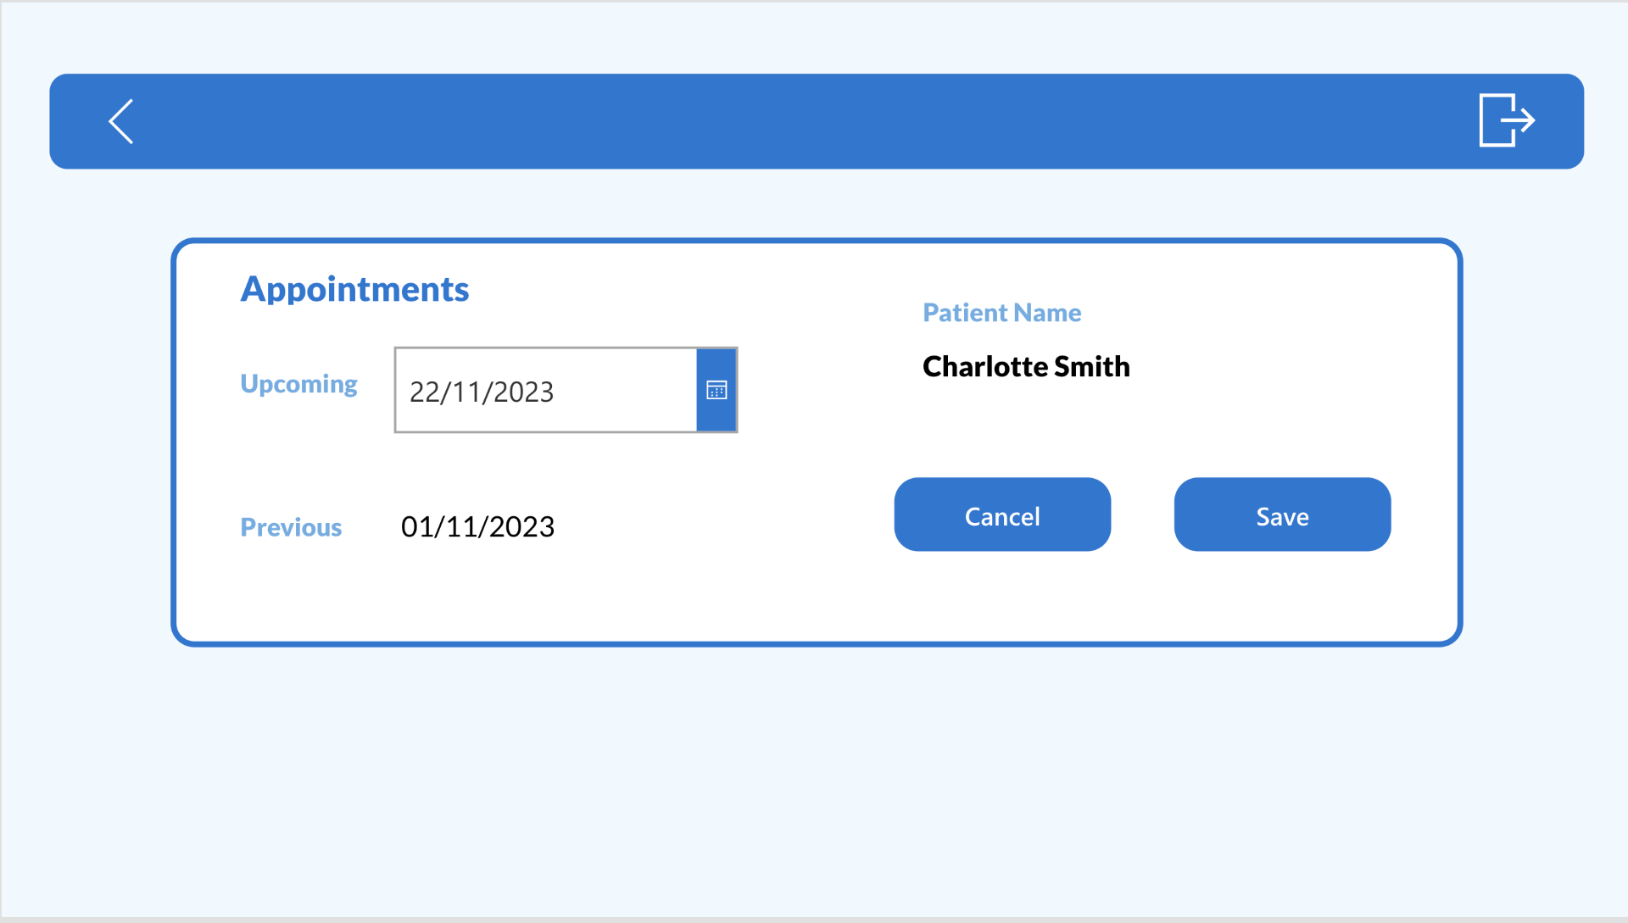
Our
Solution
User-Friendly

Slide 16
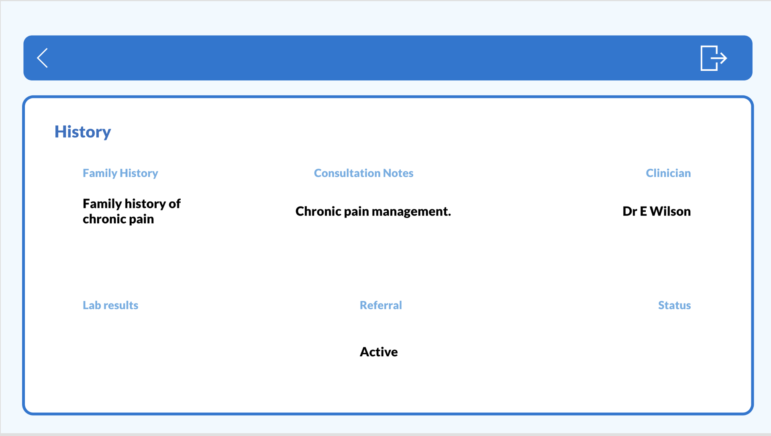
Our
Solution
User-Friendly

Slide 17
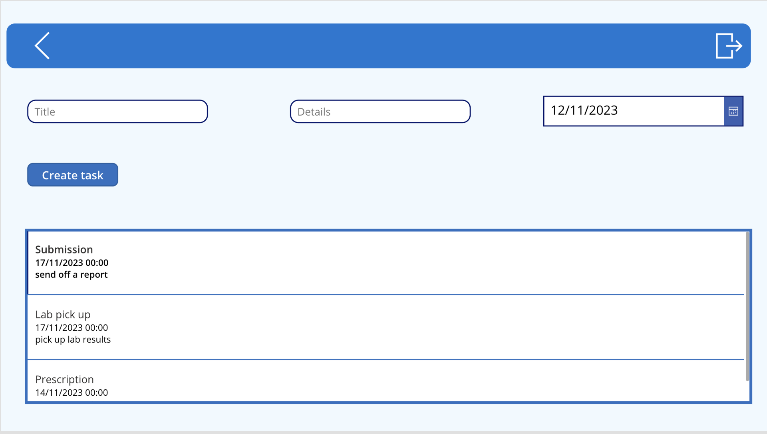
Our
Solution
User-Friendly

Slide 18
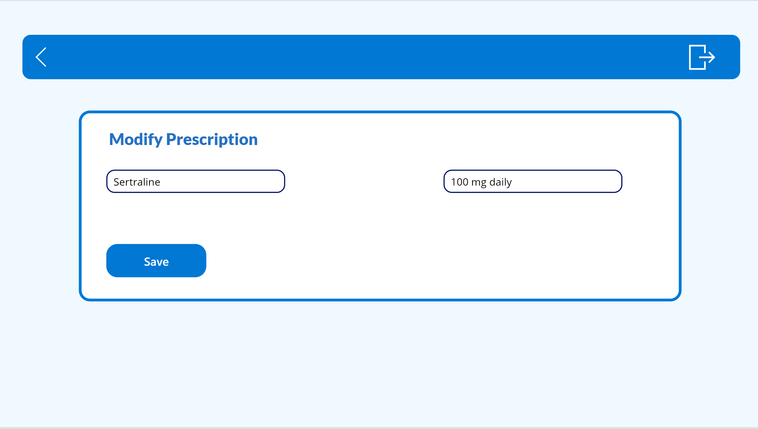
Our
Solution
User-Friendly

Slide 19
Our
Solution
User-Friendly

Slide 20

Q&A

Slide 21
Thank you!

